Slide 1
Unit 13 Assignment 1
The Use and Features of Websites
Notes:
Halo my name is David

Slide 2
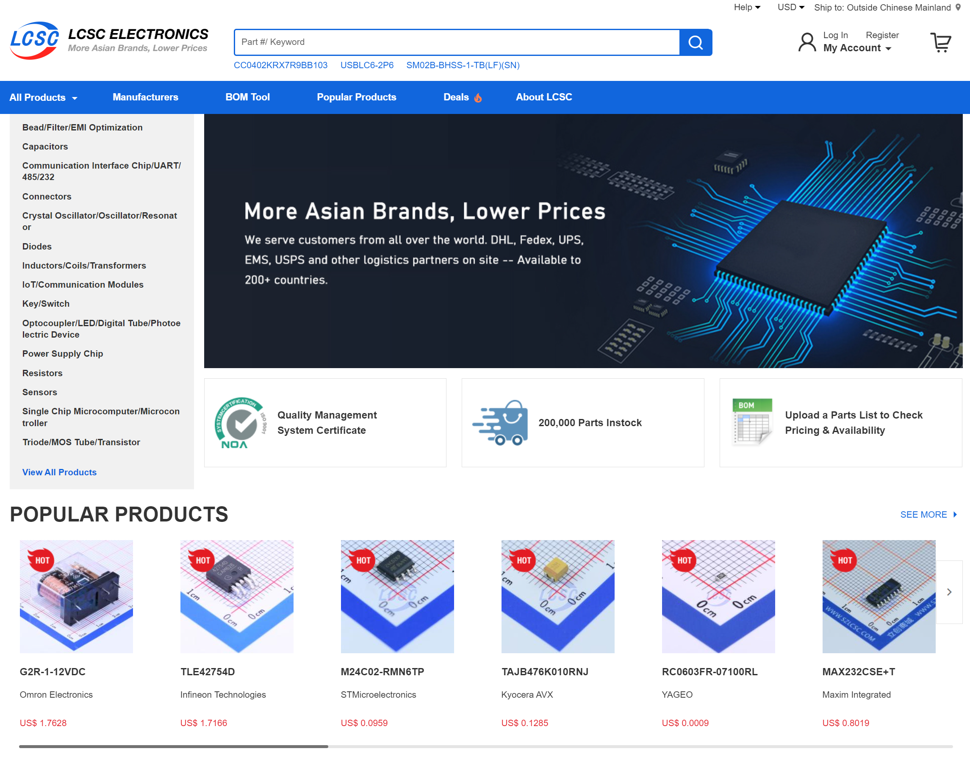

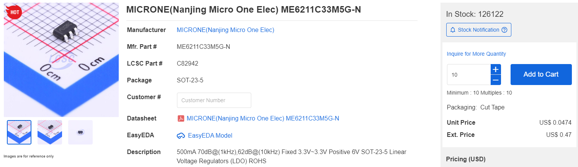
Websites 1
My first website is LCSC.
LCSC
Link
the purpose of LCSC
the purpose of LCSC is to sell products, in this case it is electronics, LCSC is an e-commerce website, it sells electronic products to a wide range of customers from hobbyists to companies.
The Information presented
the information LCSC displays on its website ah thousands of electrical components, with a wide range of uses. It displays links to the data sheets of these components and whether they are in stock. It also show the price and has a part number for each product, so it is easier to find them in CAD software's for electrical designers.
What information is stored
LCSE will require the e-mail address of the customer and bank details to buy anything, it will need a postal address for delivery of your order as well. This information is only needed to purchase products.
Notes:
My first Websitesis LCSC. LCSC is a e-comers websites that sels

Slide 3
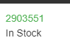
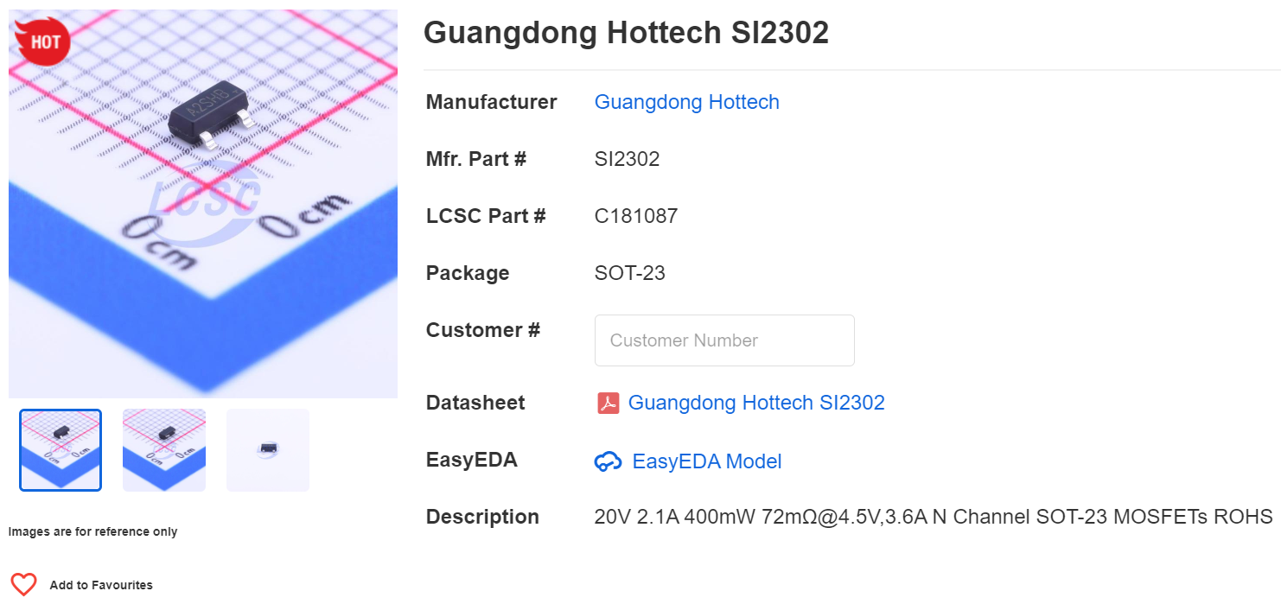

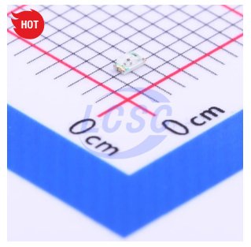
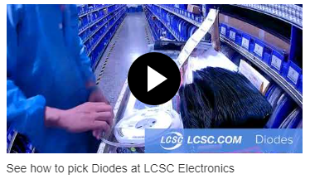
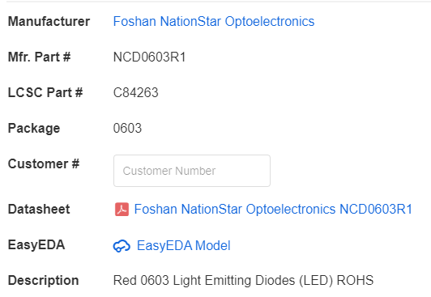
Real time information displayed
Reil time information is information which is always being updated.
In LCSC real time information is used to displace weather items are in stock or not, this helps the user when ordering products so they know how quickly they can be delivered.
How do they communication with their audience?
LCSC communicates through the website by using text show whether items are in stock add to communicate what is in the use's basket.
media used and shown
LCSC has media in the form images to show the product to the customers. It also has videos to show the process of how they find your orders and ship them. In LCSC it uses the images two show the product and it has a zoom function to give the user a better look at the product. The images presented will help show the product to the user of the site It will give them a better feel what they're buying which can help increase sales.
e-commerce element of the website
E-commerce is commercial transactions, taken place on the Internet.
LCSC is an e-commerce website does it is selling electrical products on the Internet.
downloadable files
Downloadable file is a file that can be downloaded from a website onto the user's computer.
LCSC, he doesn't have any directly download files, but it has links to date sheets that can be downloaded.
They could add a direct way of downloading the data sheets or other details about the product directly rather than fruit of science.

Slide 4

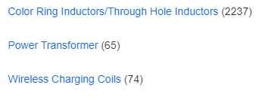
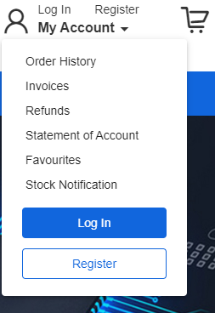
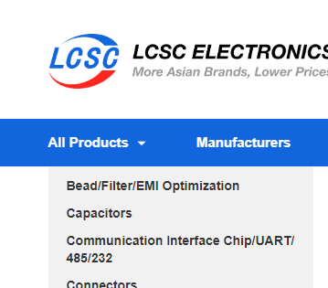
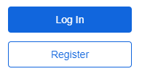
How the features of the website enhance user experience
What is a hyperlink
A hyperlink is something displayed on the page normally text which when clicked well direct use it to a different URL.
LCSC users a hyperlink to link to the data sheet of the components it is selling, this is an external hyperlink because it is linking to a different domain. this hyperlink improves the user experience byline for quick access to he dated sheet of the product that they are interested in.
LCSC also has internal hyperlinks between pages of the website. These hyperlinks can improve the user experience by line for easier navigation of this site.
Buttons
LCSC, user's buttons which popped down into displays when they are hovered over this increases the user experience by keeping the website simple and clutter free while also allowing quick access to the information that the user needs.
Hot spots
LCSE uses hotspots to direct uses attention to create a simpler and more enjoyable experience by directing users' attention to relevant information. An example of this is the bright but not too bright blue PA with buttons to the rest of the sites which stands out which will help the user navigate the site.
Logins
You can log in or register yourself in LCSC this will save your information. This can make it easier for the user because it worked be such an extensive process for buying things each time.
Accessibility
LCSC is a very accessible site it can be accessed using all web browsers and it's very easy to find. LCSC's navigation could be complicated for unexperienced uses although it is logical.

Slide 5
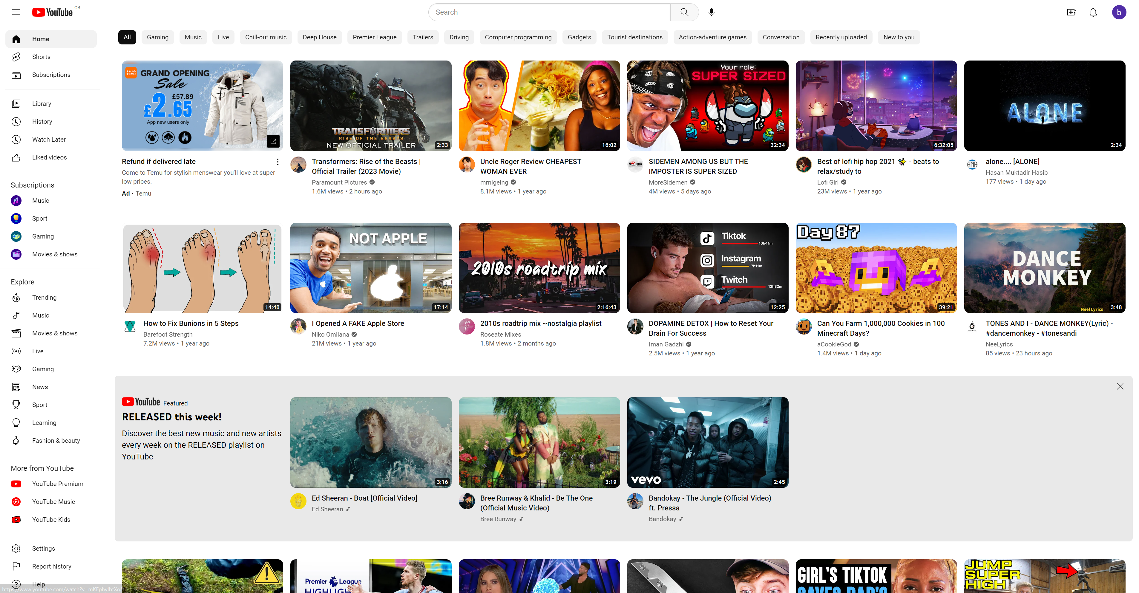



Websites 2
My first website is YouTube.
YouTube
Link
the purpose of YouTube
the purpose of YouTube is to entertain and educate its uses. YouTube has a wide range of content and audiences it also has movies and shows.
What Information is presented
YouTube presents videos for entertainment most of its videos have been uploaded to the site by content creators who can earn money off ads. YouTube also has movies and shows which can be bought for a small price.
What information is stored
The information YouTube requires from the user is a e-mail address to log in or create a channel and bank details if you have a monetized channel and earning money off adds. YouTube auto stores your watch history this can be removed or turned off on your Google account.

Slide 6
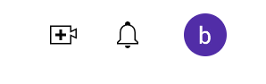
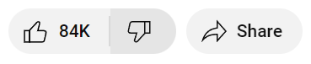
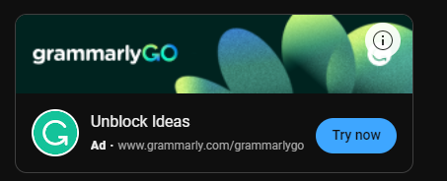

real time information displayed
YouTube can stream life video this is real time information because it is constantly being updated based on real events. This can be useful for content creators and viewers because you can do live donations and interact with your viewers.
communication with their audience
YouTube has notifications two notify the user if a creator has uploaded a video that they have subscribed to. It can also show how many likes or dislikes a video has got and how well people have received it like it's useful for content creators.
media shown on the website
YouTube displays video an audio in many forms such as music or talking. these forms of media are used to entertain the user or promote products such as in adds.
e-commerce element to the website
YouTube can't sell movies and shows tweets viewers that is used to advertise products activist and money for content creators.
downloadable files
A downloadable file is a file that can be downloaded onto the user's device.
YouTube has a ability to download its content onto the user's device if the user has a premium subscription which has a small fee to have.

Slide 7

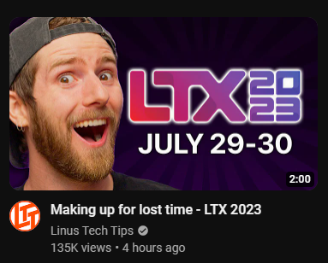
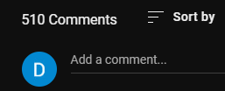
How the features of the website enhance user experience
What is a hyperlink
A hyperlink is a link normally text which links the user when clicked on to another URL. an internal URL will link to a sight within the same domain and an external URL we'll link to a different domain.
If you are signed in there is a hyperlink to your Google account in YouTube so you can manage the settings of your account there. There are more links to different videos and pages within YouTube. these hyperlinks will increase the user experience bye making easier navigation between different pages of the domain
Buttons
YouTube uses buttons to subscribe or like videos as well as many other uses, the user experience by my interaction with the site and easier navigation. it also has symbols on the bottom so it is easier to understand
Hot spots
YouTube uses hotspot spy having the capabilities of adding thumbnails two the creator's videos which helps focus the user on the content which can helps then engage with the side and have a better experience.
Registration and logins
YouTube has a login option which allows you to create YouTube channels and upload content to the channel for free. other features that cum with logging are you can subscribe to channels and like comment on videos and it will notify you if the channels you have subscribed to you upload videos. This drastically improved the experience of the site by adding more interaction and communication with other users.
input
The user can input whether they like or dislike videos and comment on them give feedback to the creators.
Accessibility
YouTube is a very easily accessed site with easy navigation and use which is suitable for nearly everybody from all different backgrounds and situations. This improves the experience of the signed by having minimal problems based on limitations the person might have.

Slide 8
Comparison
The two websites I am comparing our YouTube and LCSC. The obvious differences are that LCSC is an ecommerce website then YouTube is an entertainment and media site. LCSC and YouTube both use similar forms of features like hotspots buttons and logging features all the LCSC does not have the ability to add comments to his products although this isn't really necessary.
strengths and weaknesses of LCSC
The strengths of LCSC ah it is easy to navigate and has many features like links to data sheets and part numbers which make it easier to use the site. LCSC also has nice designs and navigation with nice images with consistent backgrounds so you can see the size of the item that you're buying.
the weaknesses of LCSC that date it's hard for new people to navigate site and can be complicated for an experienced user. Another weakness is it the search bar will only show a result if you search a part number and not a general product.
Overall I would rate LCSC as a 7 out of 10
I would improve LCSC by creating easier navigation. and I would add the capabilities for searching for general products and not just part numbers.
strengths and weaknesses of YouTube
The strengths of YouTube are that it is easy to navigate and use for people from many age groups and disabilities. and it's very entertaining and can be very useful for education at sharing information. And it's use of media and navigation, at the way it allows for feedback and communication between different uses of the site.
The weaknesses of YouTube are that it no longer shows the number of dislikes on the dislike button and the algorithm can demonetise videos for no reason, although there aren't really any other weaknesses to YouTube.
Overall I would rate YouTube as a 7 out of 10
I would improve YouTube by adding the viewing of the not a tear of dislikes on the dislike button.

